Slide 1
Shell Bootcamp 2024 – TECHNICAL FOUNDATION Reflections for Day 5 (04-Sep-2024)
Hitesh
Date : 06-Sep-2024

Slide 2

My learnings from this week!

Slide 3
Learning 1 | My takeaways
DBMS (Database Management System)
Definition: Software that manages and controls databases, enabling data storage, retrieval, and manipulation.
Functions: Supports data organization, ensures data integrity, and handles transactions.
Examples: MySQL, Oracle, PostgreSQL, Microsoft SQL Server.
Types of Databases
RDBMS (Relational Database Management System):
Organizes data into tables with rows and columns. Uses SQL for querying.
Example: MySQL, PostgreSQL.
Distributed Database:
Data is stored across multiple physical locations. Ensures high availability and reliability.
Example: Google Spanner, Cassandra.
Data Warehouse:
Central repository for integrated data from various sources, optimized for querying and analysis.
Example: Amazon Redshift, Snowflake.
NoSQL Database:
Designed for unstructured data and supports a variety of data models like document, key-value, graph, etc.
Example: MongoDB, Couchbase.
Graph Database:
Uses graph structures with nodes, edges, and properties to represent and store data.
Example: Neo4j, Amazon Neptune.
Online Transaction Processing (OLTP) Database:
Manages transactional data, typically for real-time applications.
Example: PostgreSQL, MySQL.

Slide 4
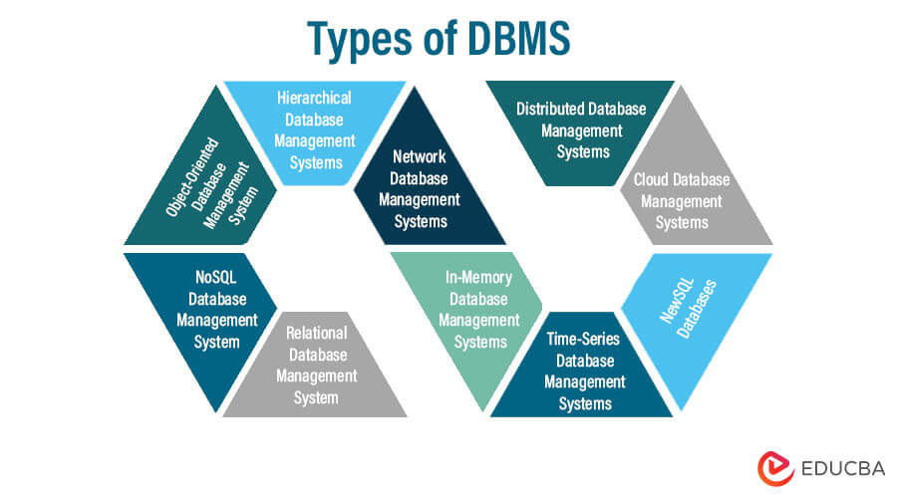
Learning 1 | My takeaways

Slide 5
Learning 2 | My takeaways
Data Operations
Data Updation:
Updating values in rows and columns within a database table.
Data Retrieval:
Extracting data using SQL queries.
Example: SELECT * FROM table_name;
PostgreSQL and JSON:
PostgreSQL supports storing and querying JSON data, allowing for flexible data modeling.
SQL vs. PostgreSQL
SQL: A standard language for querying databases.
PostgreSQL: An advanced RDBMS that uses SQL, with additional features like JSON support.
Types of SQL Operations
DDL (Data Definition Language):
CREATE: Creates a new table or database.
ALTER: Modifies an existing table structure.
DROP: Deletes a table or database.
TRUNCATE: Removes all records from a table, but not the table itself.
RENAME: Renames an existing table.
DML (Data Manipulation Language):
SELECT: Retrieves data from a database.
INSERT: Adds new records to a table.
UPDATE: Modifies existing records in a table.
DELETE: Removes records from a table.
DCL (Data Control Language):
GRANT: Provides privileges to users.
REVOKE: Removes privileges from users.

Slide 6
Learning 3 | My takeaways
DQL (Data Query Language):
SELECT: Retrieves data from one or more tables.
GROUP BY: Groups rows sharing a property.
ORDER BY: Sorts result sets.
WHERE: Filters records based on conditions.
HAVING: Filters groups based on aggregate conditions.
TCL (Transaction Control Language):
COMMIT: Saves changes made in a transaction.
ROLLBACK: Reverts changes made in a transaction.
SAVEPOINT: Sets a point within a transaction to which you can rollback.
SET TRANSACTION: Sets the characteristics for the current transaction.
BEGIN: Starts a transaction.
Joins
Inner Join: Returns records with matching values in both tables.
Outer Join (Left, Right, Full): Returns all records from one or both tables, including those without a match.
Self-Join: Joins a table to itself.
Equi-Join: Uses the equality operator to join tables.
Cross Join: Returns the Cartesian product of two tables.
Natural Join: Automatically joins tables based on columns with the same name.

Slide 7
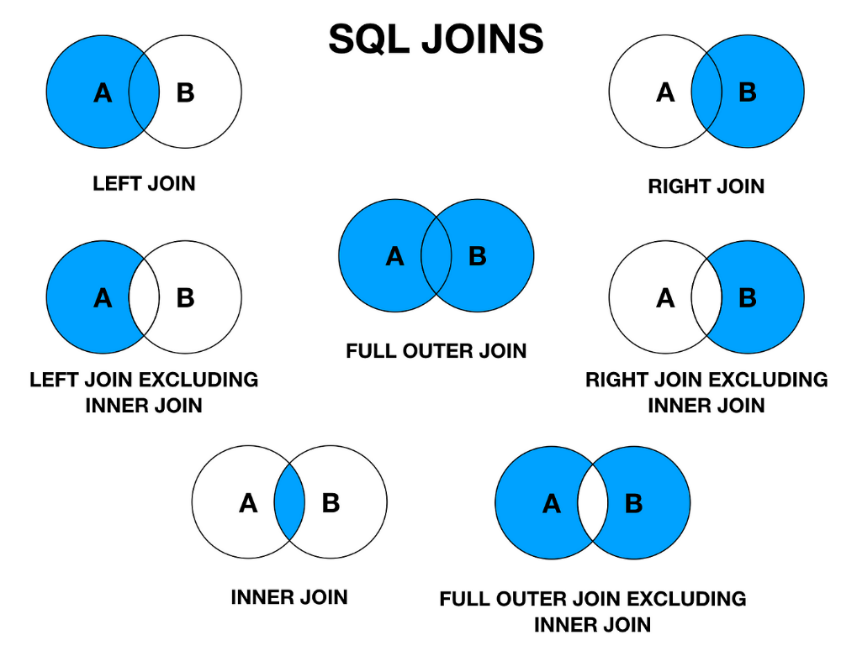
Learning 3 | My takeaways

Slide 8
Learning 4 | My takeaways
Keys
Primary Key: A unique identifier for each record in a table.
Secondary Key: Non-primary key used for additional indexing and retrieval.
Normalization
1NF (First Normal Form): Ensures atomicity by handling multi-valued columns.
2NF (Second Normal Form): Ensures no partial dependencies, where non-prime attributes depend only on the entire candidate key.
3NF (Third Normal Form): Ensures no transitive dependencies and maintains referential integrity.
BCNF (Boyce-Codd Normal Form): Addresses anomalies not covered by 3NF.
4NF (Fourth Normal Form): Ensures no multi-valued dependencies.
5NF (Fifth Normal Form): Ensures no join dependencies and prevents data redundancy.

Slide 9
Learning 5 | My takeaways
-- SQL SCRIPT
-- Create a table for books
CREATE TABLE Books (
BookID INT PRIMARY KEY,
Title VARCHAR(100),
Author VARCHAR(100),
PublishedYear INT
);
-- Create a table for members
CREATE TABLE Members (
MemberID INT PRIMARY KEY,
Name VARCHAR(100),
JoinDate DATE
);
-- Create a table for borrowing records
CREATE TABLE BorrowingRecords (
RecordID INT PRIMARY KEY,
BookID INT,
MemberID INT,
BorrowDate DATE,
ReturnDate DATE,
FOREIGN KEY (BookID) REFERENCES Books(BookID),
FOREIGN KEY (MemberID) REFERENCES Members(MemberID)
);
-- Insert sample data into Books
INSERT INTO Books (BookID, Title, Author, PublishedYear) VALUES
(1, '1984', 'George Orwell', 1949),
(2, 'To Kill a Mockingbird', 'Harper Lee', 1960),
(3, 'The Great Gatsby', 'F. Scott Fitzgerald', 1925);
-- Insert sample data into Members
INSERT INTO Members (MemberID, Name, JoinDate) VALUES
(1, 'Alice Johnson', '2023-01-15'),
(2, 'Bob Smith', '2023-02-20'),
(3, 'Charlie Brown', '2023-03-10');
-- Insert sample data into BorrowingRecords
INSERT INTO BorrowingRecords (RecordID, BookID, MemberID, BorrowDate, ReturnDate) VALUES
(1, 1, 1, '2023-04-01', '2023-04-15'),
(2, 2, 2, '2023-04-05', '2023-04-20'),
(3, 3, 3, '2023-04-10', '2023-04-25');
-- Update a record in the Books table
UPDATE Books
SET PublishedYear = 2000
WHERE BookID = 3;
-- Select all records from the Books table
SELECT * FROM Books;
-- Find the minimum PublishedYear
SELECT MIN(PublishedYear) FROM Books;
-- Find members with names starting with 'Bob'
SELECT * FROM Members
WHERE Name LIKE 'Bob%';

Slide 10
Learning 6 | My takeaways
-- Count the number of books
SELECT COUNT(*) FROM Books;
-- Describe the Books table (PostgreSQL specific)
\d Books;
-- Joins
-- Inner Join
SELECT Members.Name, Books.Title, BorrowingRecords.BorrowDate
FROM BorrowingRecords
INNER JOIN Members ON BorrowingRecords.MemberID = Members.MemberID
INNER JOIN Books ON BorrowingRecords.BookID = Books.BookID;
-- Left Join
SELECT Members.Name, Books.Title, BorrowingRecords.BorrowDate
FROM BorrowingRecords
LEFT JOIN Members ON BorrowingRecords.MemberID = Members.MemberID
LEFT JOIN Books ON BorrowingRecords.BookID = Books.BookID;
-- Right Join
SELECT Members.Name, Books.Title, BorrowingRecords.BorrowDate
FROM BorrowingRecords
RIGHT JOIN Members ON BorrowingRecords.MemberID = Members.MemberID
RIGHT JOIN Books ON BorrowingRecords.BookID = Books.BookID;
-- Full Outer Join
SELECT Members.Name, Books.Title, BorrowingRecords.BorrowDate
FROM BorrowingRecords
FULL OUTER JOIN Members ON BorrowingRecords.MemberID = Members.MemberID
FULL OUTER JOIN Books ON BorrowingRecords.BookID = Books.BookID;
-- Self Join
SELECT A.Name AS Member1, B.Name AS Member2, A.JoinDate
FROM Members A
JOIN Members B ON A.JoinDate > B.JoinDate;
-- Equi Join
SELECT Members.Name, Books.Title, BorrowingRecords.BorrowDate
FROM BorrowingRecords
JOIN Members ON BorrowingRecords.MemberID = Members.MemberID
JOIN Books ON BorrowingRecords.BookID = Books.BookID;
-- Natural Join
SELECT Members.Name, Books.Title, BorrowingRecords.BorrowDate
FROM BorrowingRecords
JOIN Members ON BorrowingRecords.MemberID = Members.MemberID
JOIN Books ON BorrowingRecords.BookID = Books.BookID;

Slide 11
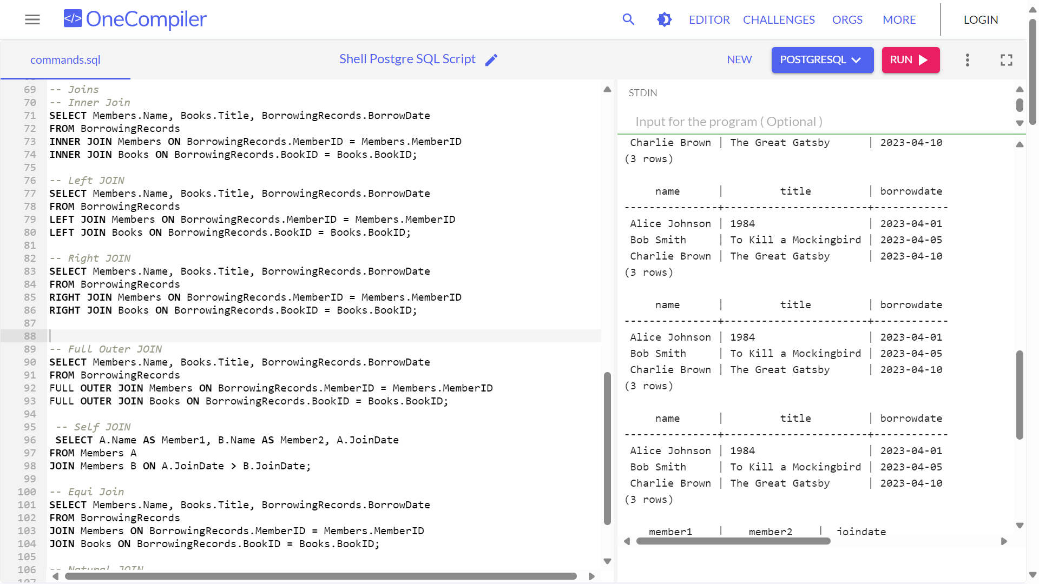
Learning 7 | My takeaways

Slide 12
Thank You

